Slide 1
Mastery Topic 14
In particular knowledge of Extreme Programming

Slide 2
What is XP?
“Extreme Programming is a discipline of software development based on values of simplicity, communication, feedback, courage, and respect. It works by bringing the whole team together in the presence of simple practices, with enough feedback to enable the team to see where they are and to tune the practices to their unique situation”

Slide 3
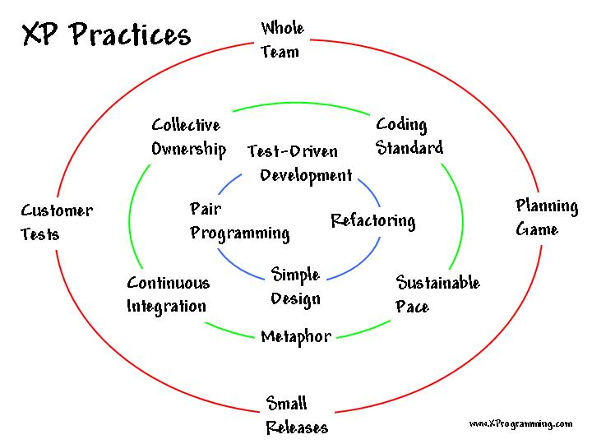
Extreme Practices

Slide 4
Extreme Values
Simplicity: Do only what’s necessary, no more
Communication: Enables team work and better solutions for any problem
Courage: Tell always the truth; Evereyone is together in this.
Respect: Give everyone their value
Feedback: Hear what others have to say and make the code better

Slide 5
Bibliography
http://www.extremeprogramming.org/
http://xprogramming.com/index.php

